Slide 1

Reconstructive Strategy & Digital Transformation
Tooraj Helmi
2018

Slide 2
What is Strategy?
STRATEGY is about:
What goods to sell?
How to build it?
To whom to sell it?
At what price?
With what performance?
How to repeat the sell?
OPERATIONS
Specifies how work is done daily
Implemented via business processes
Include measurable components: sales forecast, resource capacity, budgets (OP-EX, CAP-EX)
Strategy
Sustains
Executes
Operations

Slide 3
Don’t Get Trapped in the Existing Structure
Beyond Structure
Strategy Creates Structure
Within Structure
Structure Shapes Strategy
In Search of Competitive Advantage
Leads to imitated or imitative product
Leads to innovation
Generates Unique Advantage

Slide 4
Question and break existing constraint
Reject existing constraints
Forget about which industry you are playing in
It’s not either low cost OR differentiation, it is low cost AND differentiation
Price
Value Innovation
Sell More Experience at Lower Price
Sell Less
Differentiated Product at Higher Price
Sell More Commodity at Lower Price
QUANTITY

Slide 5
Find an opportunity But extend beyond
Firm D
Firm D
Firm A
Firm A
Firm C
Firm C
Firm B
Firm B
Notes:
Start with the new challenge but redefine and expand into existing.

Slide 6
Out, In, Out Again
Observe opportunities from a distance
Study restrictions close by
Apply possible opportunities as seen from outside

Slide 7
Different Mindset
Existing Challenge
Disruption
New Challenge
Competition
New Solution
New Solution
Reconstruction
Redefine Challenge (Existing + New Challenge)
Expanded Solution

Slide 8
What Different Strategies exists and Why?
Competitive Strategy
Locally win against existing competition
Cannot be long-term reason to exist since change is inherent in and around us
Reconstructive Strategy
Globally reconstructs a new position beyond the existing competition
Can produce continuous reasons to exist to adjust to and be the source of change
Disruptive Strategy
Locally reconstructs a new position within existing competition
Can produce short-term change

Slide 9
How Can Technology Help?
Supporting a stabilizing strategy
“Enterprise Architecture”
Supporting a reconstructive strategy
“Digital Transformation”
As the fastest changing phenomenon around shapes what customers demand
Provides unique ways to create reconstructive strategies around customer, competition, data, innovation, and value
Automates repetitive tasks →reduces labor → reduces cost
Increases accuracy and speed of processes → more customers to be serves at a higher quality → increases revenue and growth
Increases employee productivity → Reduces cost and increases revenue
Works along two dimensions integration or standardization
Supporting a disruptive strategy
"Tech Startup"
Great way to build platforms
Majority of the last decade startups are tech startups

Slide 10
Stabilizing/Competitive Strategy & Enterprise Architecture
How technology can help implement a stabilizing strategy using standardization & integration

Slide 11
Competitive Strategy

Slide 12
Framework: Enterprise Architecture

Slide 13
Tool 1: Cloud Enables A Well-Architected Framework
Operational Excellence
Monitor systems
Anticipate failure
Security
Maintain the confidentiality and integrity of data
Identify security incidents
Reliability
Scale horizontally to increase availability
Performance Efficiency
Only pay when using
Cost Optimization
Democratize advanced technologies
Go global in minutes
Experiment more often
Share unused capacity (PaaS)
Automatically recover from failure
Stop guessing capacity
Protect information, systems, and assets
Perform operations as code

Slide 14
Tool 2: Digital Workplace

Slide 15
Tool 3: Cloud Migration

Slide 16
Reconstructive strategy & Digital Transformation
Design reconstructive strategies using digital transformation

Slide 17
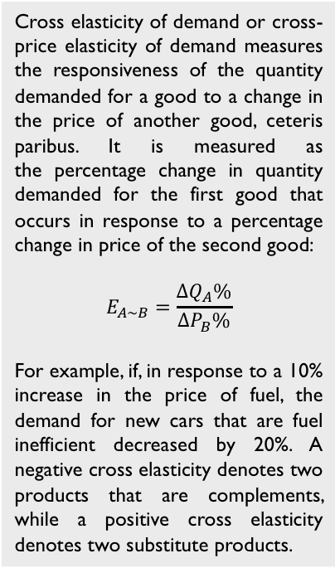
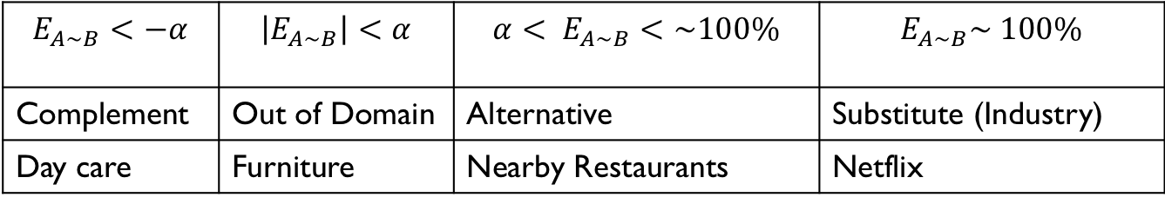
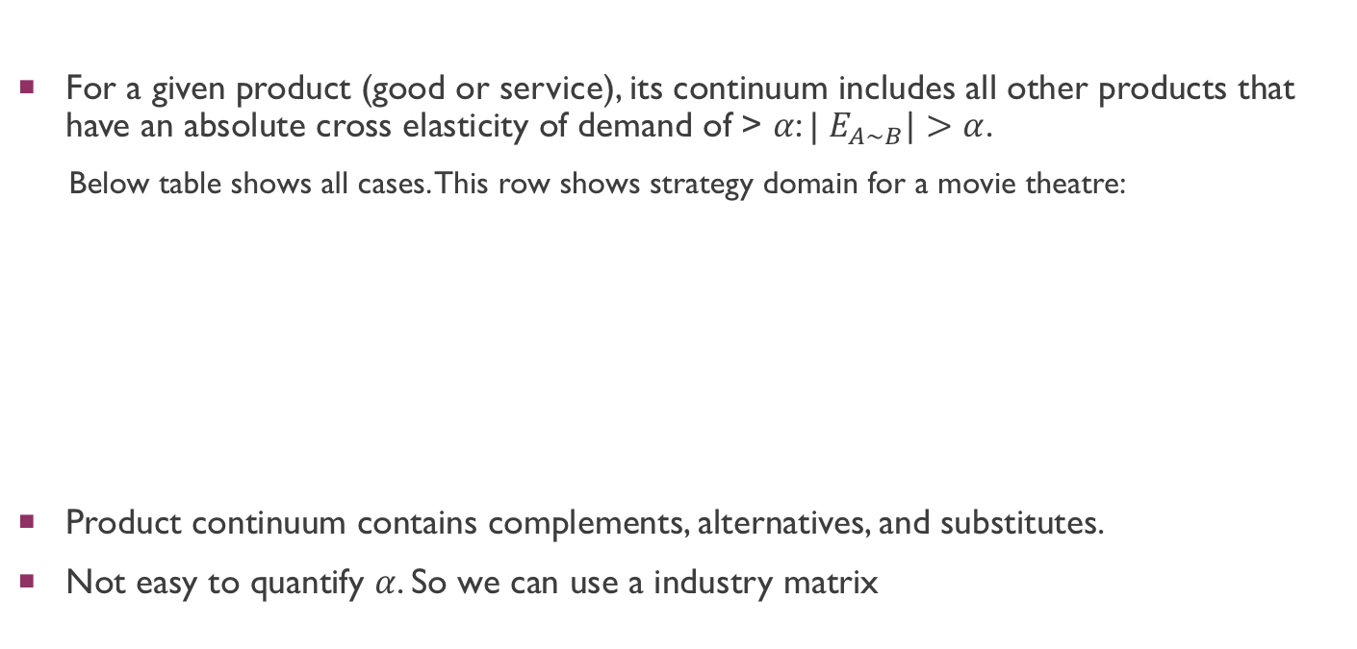
Product Dimension
For a given product (good or service), its continuum includes all other products that have an absolute cross elasticity of demand of > $α$: | $E_{A\sim B}|>$ $α$.
Below table shows all cases. This row shows strategy domain for a movie theatre:
Product continuum contains complements, alternatives, and substitutes.
Not easy to quantify $α$. So we can use a industry matrix
Cross elasticity of demand or cross-price elasticity of demand measures the responsiveness of the quantity demanded for a good to a change in the price of another good, ceteris paribus. It is measured as the percentage change in quantity demanded for the first good that occurs in response to a percentage change in price of the second good:
$$E_{A\sim B}=\frac{{∆Q}_{A}\%}{{∆P}_{B}\%}$$
For example, if, in response to a 10% increase in the price of fuel, the demand for new cars that are fuel inefficient decreased by 20%. A negative cross elasticity denotes two products that are complements, while a positive cross elasticity denotes two substitute products.
$$E_{A\sim B}<−α$$ | $$\left|E_{A\sim B}\right|<α$$ | $$α< E_{A\sim B}<\sim 100\%$$ | $$E_{A\sim B}\sim 100\%$$
Complement | Out of Domain | Alternative | Substitute (Industry)
Day care | Furniture | Nearby Restaurants | Netflix

Slide 18
Proposition Dimension
Specific performance and price points that a firm decides to sell its product: Toyota produces mid-size cars at a low price whereas Porsche produces sports cars at high prices.
Innovative Goods
Luxury Goods
Performance
Chip Goods
Price

Slide 19
Other Dimensions
Value Dimension: set of activities that takes a product from its initial birth at a given firm to the hand of buyer.
Extended value Dimension : value dimension extended with upstream and downstream activities along that are accomplished by suppliers and buyers.
Operations Dimension: operations that take place after the product is sold to keep it usable. E.g. maintenance.
Buyer Dimension: for a given product, includes all the buyer can receive value by purchasing the product. It also includes the intermediaries that could exist before the product is received by the end-customer. E.g. clinics can be intermediaries to provide a specific medication to a patient. Both clinic and patient belong to the buyer continuum.
Demand Dimension: includes the first and all the possible subsequent opportunities to sell a product to a customer. E.g. a patient who comes for a visit to a clinic can go through multiple physician visits until he is completely healed rather than being seen by the first physician he made an appointment, given a prescription and let go.
Time Dimension includes future time epochs that a firms can predict how is strategy should be set based on existing market trends.

Slide 20
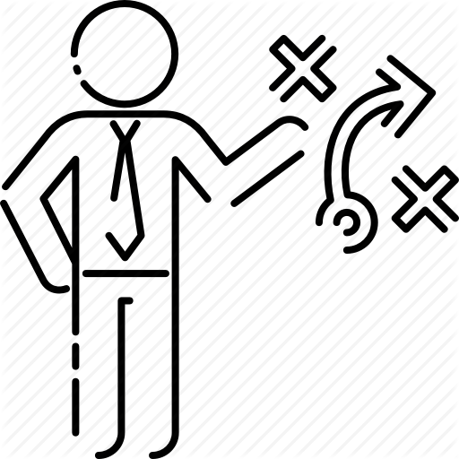
Strategy Domain
Product Dimension
Value Dimension
Operations Dimension
Proposition Dimension
Buyer Dimension
Demand Dimension
Time Dimension

Slide 21


Framework: Digital Transformation
Transforming the entire firm: redefining customer value proposition, value-added processes, and people’s working method
Customers
- Dynamic Networks
- Economies of Value
- Inspirational marketing
- Key Influencers
Operations
- Co-opetition
- Fluid Industries
- Platforms
Data
- Generated Continuously
- Unstructured Data
- Produce Information
Innovation
- Experimentation
- Problem vs Solution
- MVP & Iterations
Value
- Evolve vs Optimize
- Not industry-specific
- Futuristic Value Prop

Slide 22






Approach 1: Platforms

Slide 23
Approach 2 Microservices Organization

Slide 24
Approach 3 Omnichannel

Slide 25
Transition From Traditional to Digital IT
From Product Teams to Service Teams

Slide 26
Traditional VS Digital IT
Traditional IT Organization
Digital IT Organization
Product Team 1 | Product Team 2 | … | Product Team N
Shared Services Team
Product Team 1 | Product Team 2 | … | Product Team N
Service Team N
…
Service Team 2
Service Team 1

Slide 27
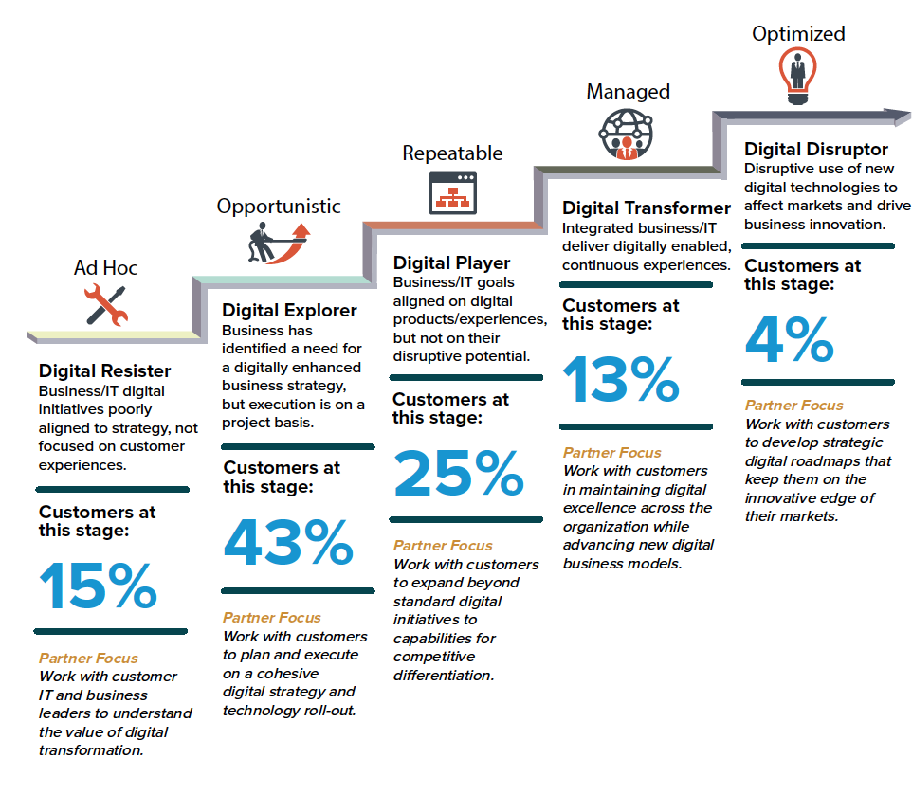
Digitalization Phases

